Slide 1


News popularity in Multiple social media platforms
Hemanth Reddy Musipatla

Slide 2
DATASET
The dataset we have selected is News Popularity in Multiple Social Media Platforms.
A large data set of news items and their respective social feedback on multiple platforms: Facebook, Google+ and LinkedIn.
We have one overall dataset that contains news related to 4 items and their popularity in 3 social media platforms.
We have 12 other social feedback datasets that contain the popularity level for every 20 mins after the news items are published.

Slide 3

PROBLEM STATEMENT
From Given News popularity and feedback Datasets, we need to do data analysis and prediction with machine learning models which helps to understand and predict the news popularity on social media and obtain the best regression model.

Slide 4
ABOUT DATA
Variables | Datatype
ID Link | Numeric
Title | String
Headline | String
Source | String
Topic | String
PublishDate | Timestamp
SentimentTitle | Numeric
SentimentHeadline | Numeric
Facebook | Numeric
GooglePlus | Numeric
LinkedIn | Numeric
It is structured dataset as it contains numerical data & text data and organized in tables with labeled columns.
Dataset is multivariate, consisting of Strings and Number
Variables in social feedback datasets: ID Link(Numeric), level of popularity of the news article on different social media platforms for every 20 mins after the news article is published.
This dataset is not a multimodel dataset.

Slide 5
WHY THIS DATASET ?
Information regarding current happenings is obtained mostly from the online newspapers and articles.
An important pre-requisite is to have a strategy to understand and predict how popular these articles are on different social media platforms.
From this analysis we can predict the future popularity of the news article published online given the popularity of news articles already published.

Slide 6
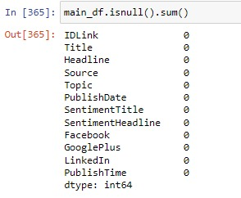
DATA CLEANING
The missing values for the source variable are replaced by the source that occurs frequently and for the rows with missing headlines the rows are deleted from the dataset as it cannot be predicted.
The news articles between November 2015 and July 2016 are only considered and the other data has been deleted based on the published date.
The duplicate rows have also been deleted.
The news articles that are not published are dropped.
For Example, here -1 indicates the news is not published and not important. Having considered only the published news these rows can be dropped.

Slide 7
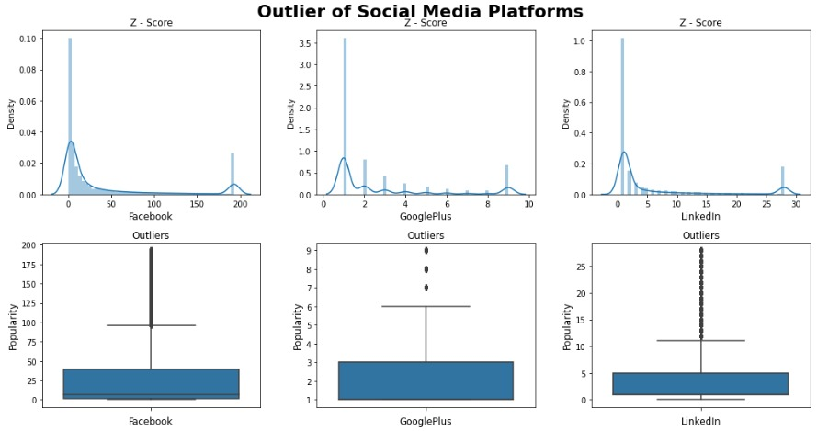

DATA CLEANING
We observed many outliers in the dataset using box plots and used the Quantile Method to treat those ouliers.
Still we got few outliers but we consider working on them.
We also used standard scalar to standardize the data.
Saving the dataset in different formats:
NPZ
Pickle
Mysql

